Slide 1

epk

Slide 2
starring:
Aretha Franklin
James Cleveland
Choir Director:
Alexander Hamilton
Guitar:
Cornell Dupree
Organ:
Kenny Luper
——
Percussion:
Poncho Morales
Drums:
Bernard Purdie
——
Bass:
Chuck Rainey
the southern california community choir:
Christine Adams
Alonzo Atkins
James A. Broomfield
Eugene Bryant
Syndrul Drahe
Mary Ann Hall
Donna J. Hammond
Darryl Hardy
Betty Hollins
Josephine Howard
Sherman James
Dolores Jones
Johannie Pearl Knox
Margerie Luper
Charles May
Charles May
Ethel Ruth McIsaac
Odessa L. McCastle
Stanley B. Miller
Linda Jean Ovenland
Lucy Ayers
Rashi Park
Linda J. Payton
Diane M. Ratcliff
Gilbert Stanley
Annette May Thomas
Bobby Washington
Aundie Wodson
Barbara Ann Wilson

Slide 3
REALIZED/produced by:
Alan Elliott
Edited by:
Jeff Buchanan
Music Mixed by:
Jimmy Douglass
Original Album Produced by:
Arif Mardin,
jerry Wexler and
Aretha Franklin
Produced by:
Joe Boyd
Rob Johnson
Chiemi karasawa
Sabrina Owens
Jerry Wexler
Tirrell D. Whittley
Joseph Woolf
Executive Produced by:
Stefan Nowicki
Joey Carey

Slide 4
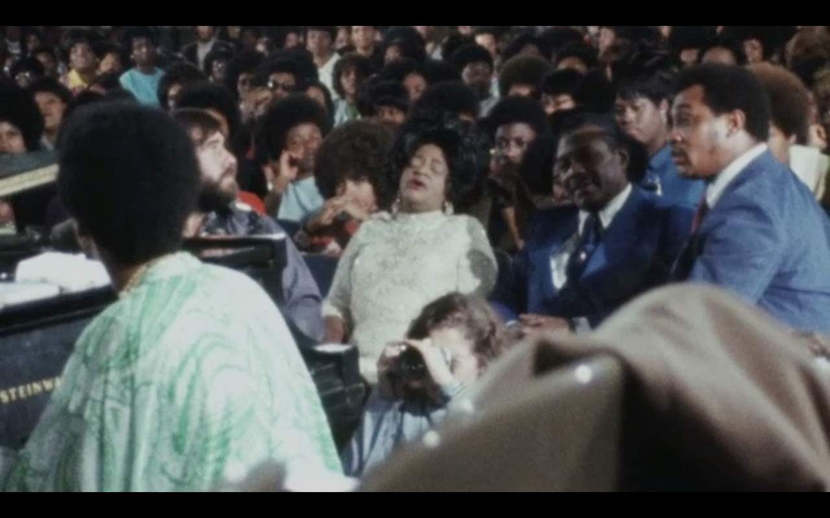
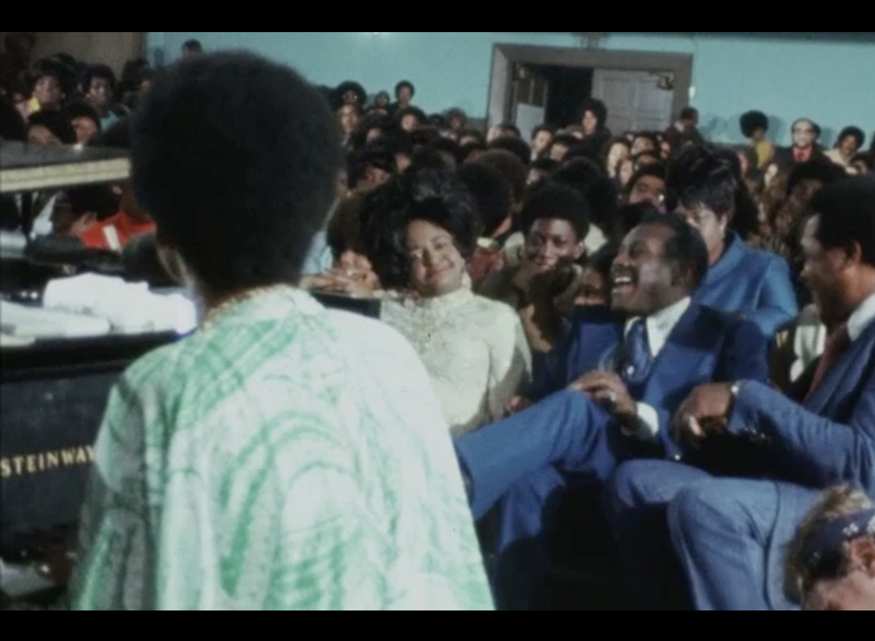
In 1971, Aretha Franklin- the Queen of Soul- was America’s biggest singing star.
Aretha and producer Jerry Wexler came to Los Angeles to make a Gospel album.

Slide 5

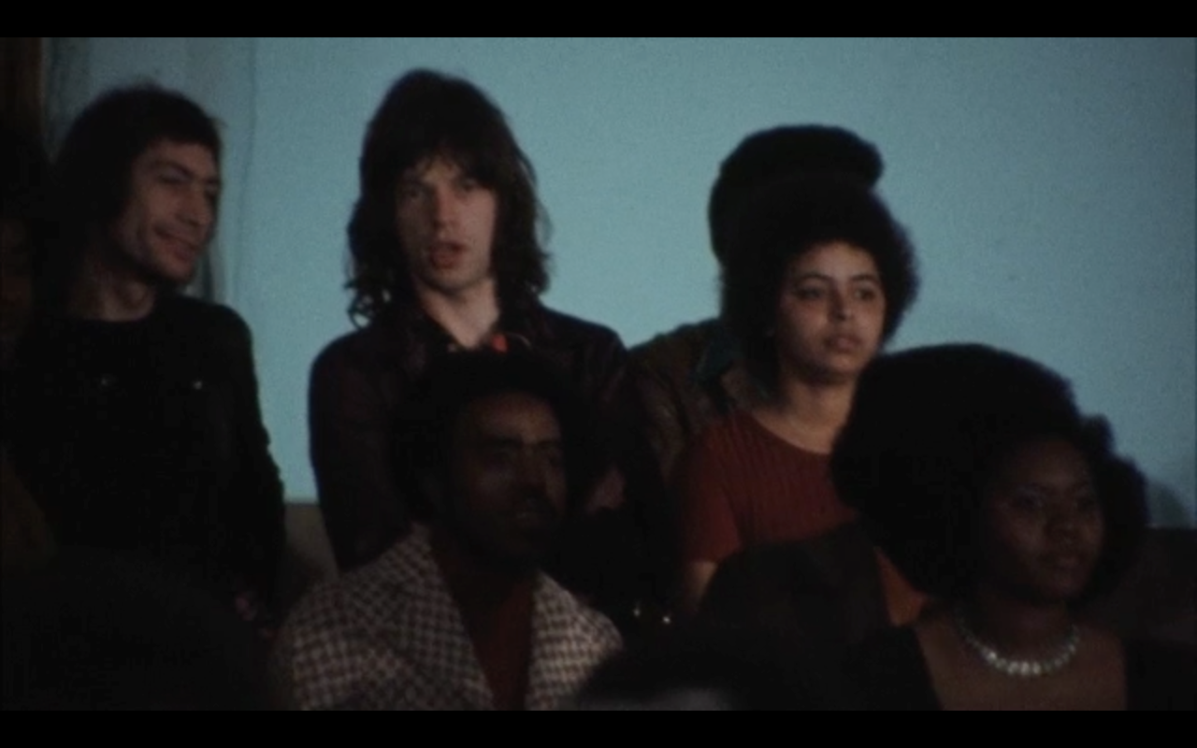

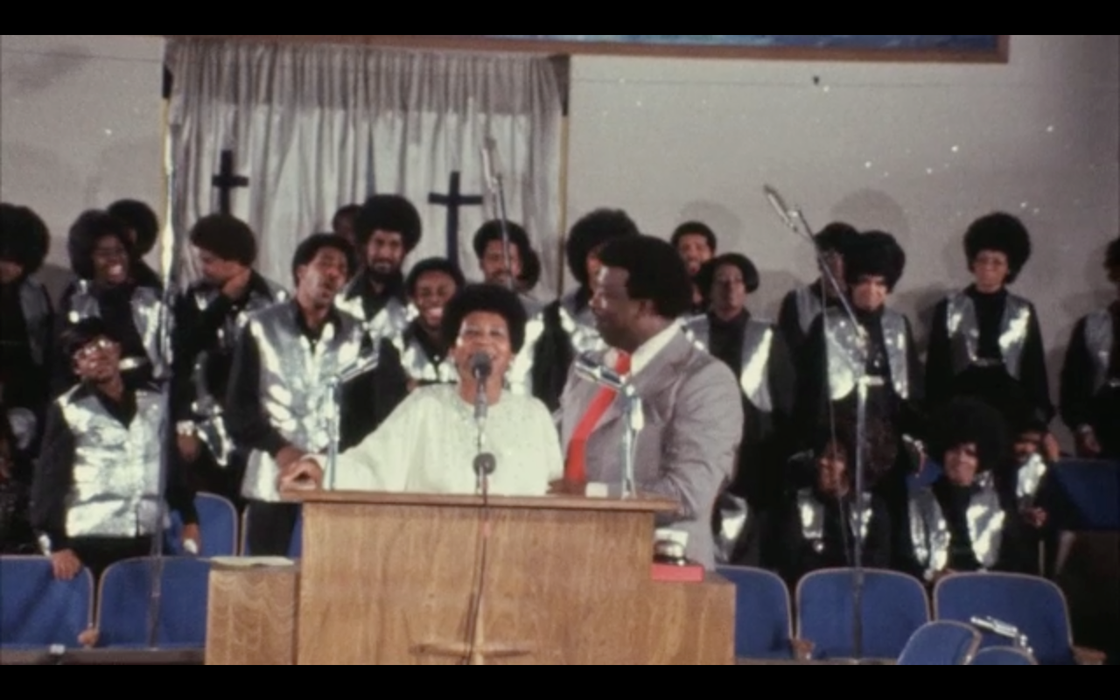

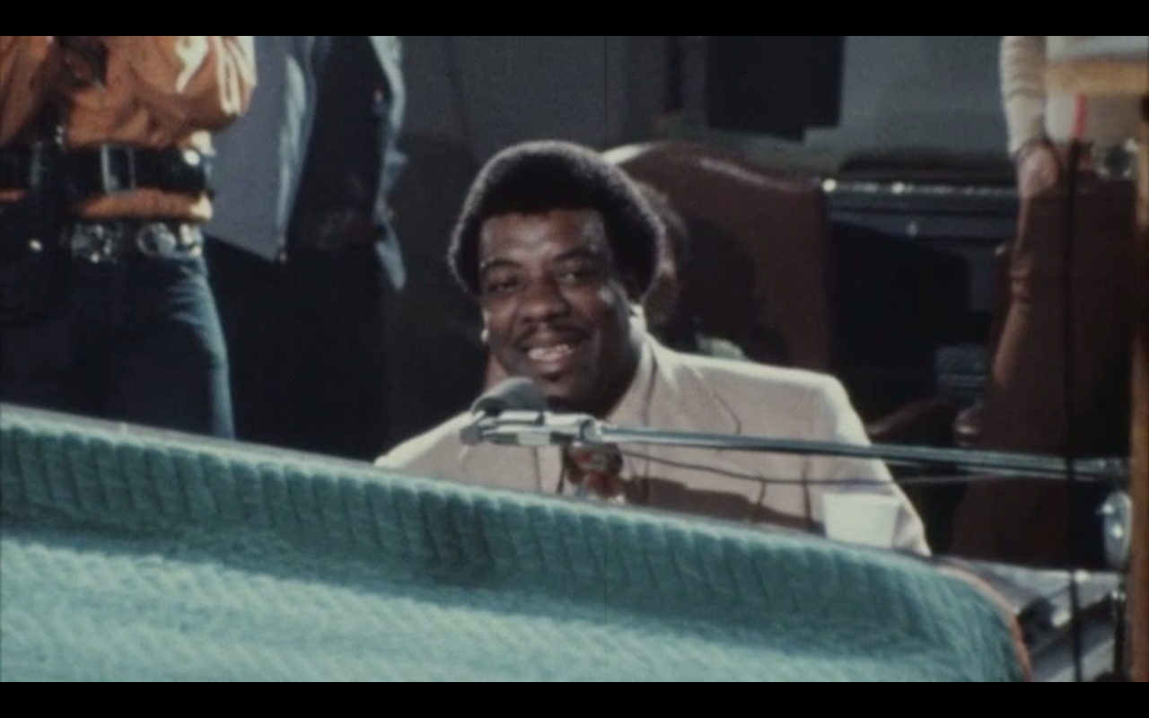

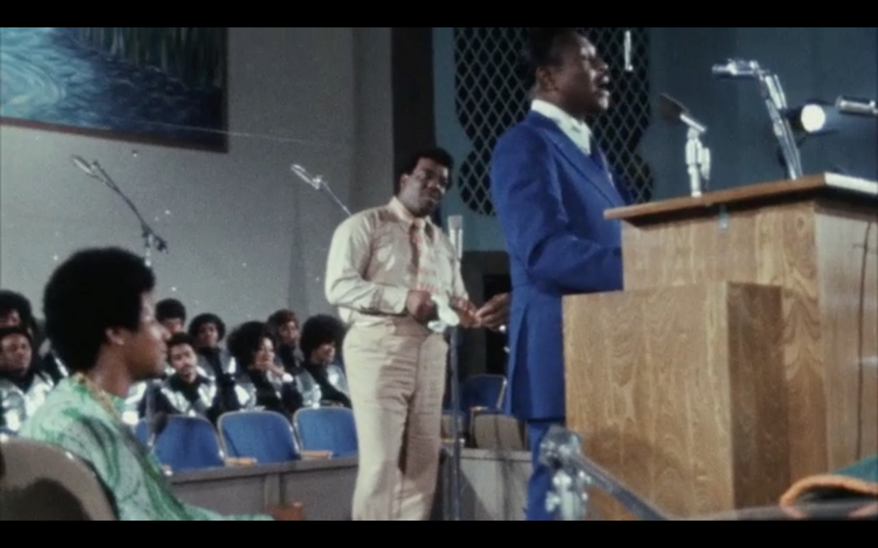

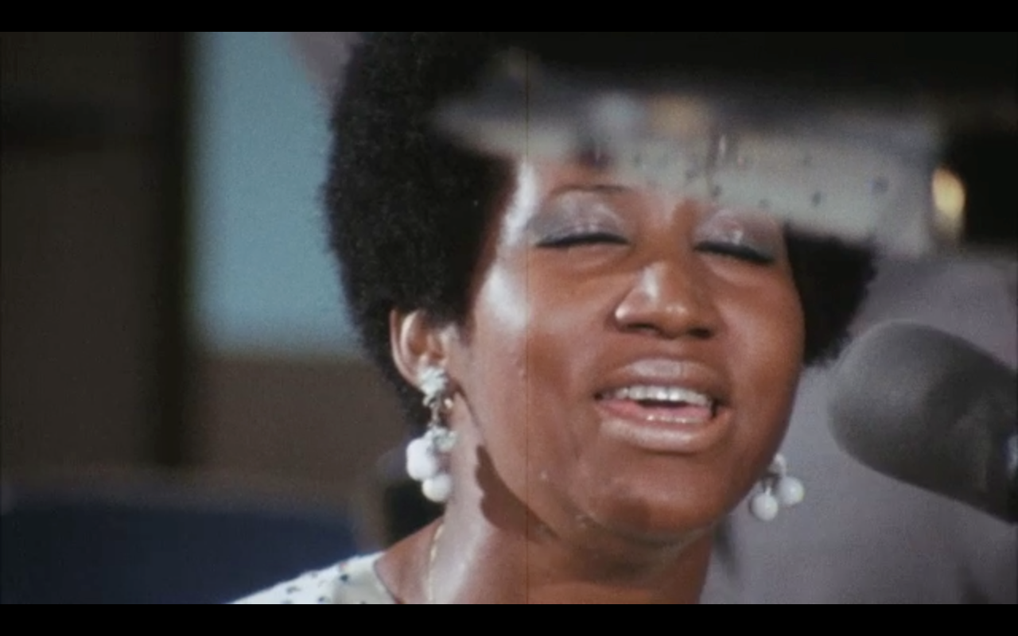



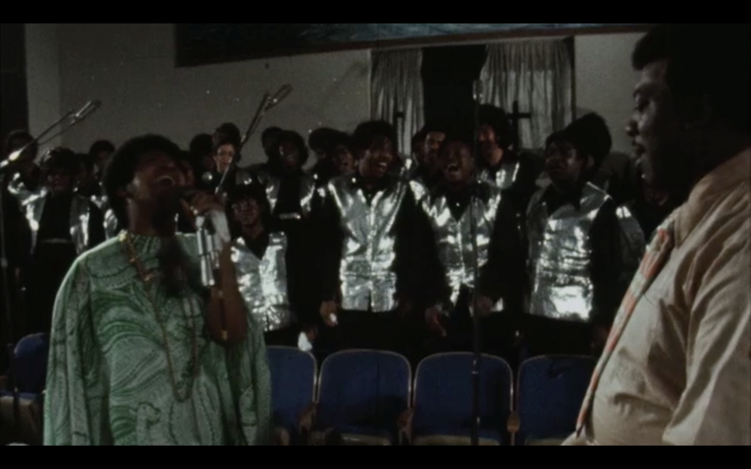
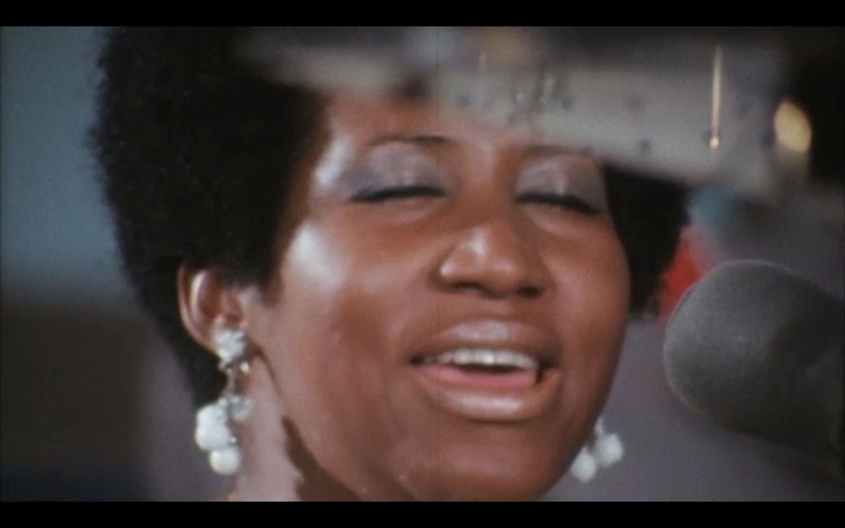
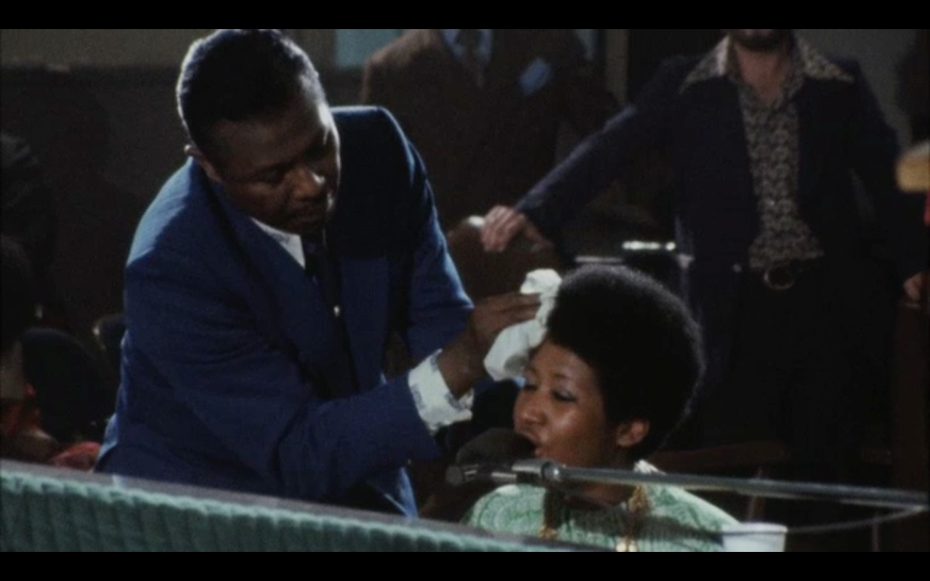
Recorded live with Rev James Cleveland in Watts, California…
“Amazing Grace” became
the biggest selling album of
Aretha Franklin’s career…
and the biggest selling Gospel
album of all time.

Slide 6

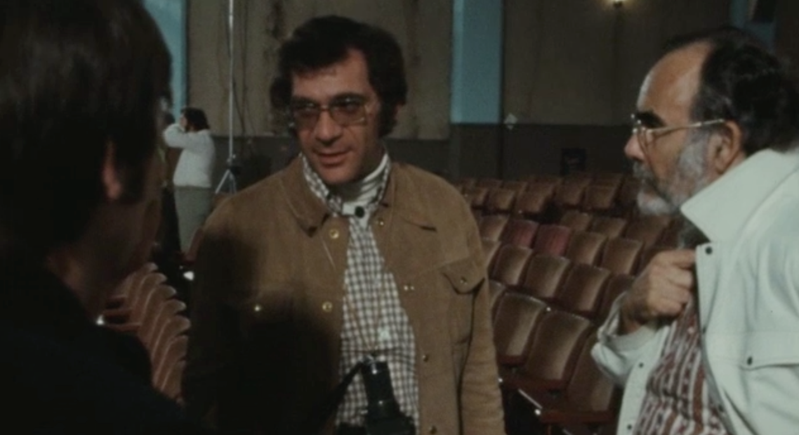
What remained a secret was that the session, which took place in front of a shouting, Amen-ing and dancing audience/congregation, had been filmed by Sydney Pollack.
40 years later, this film is a testimony to the greatness of Aretha Franklin and a time-machine window into a moment in American musical and social history.

Slide 7

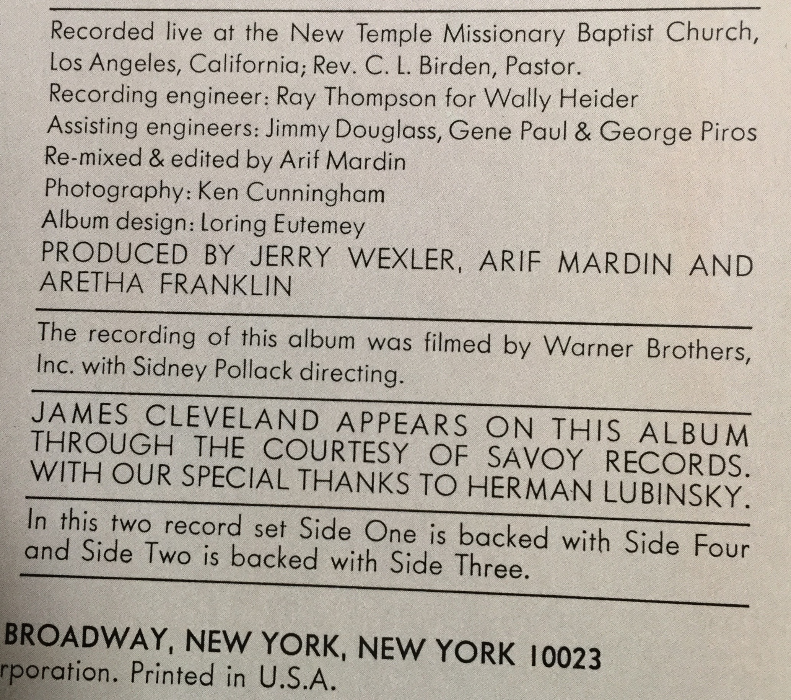
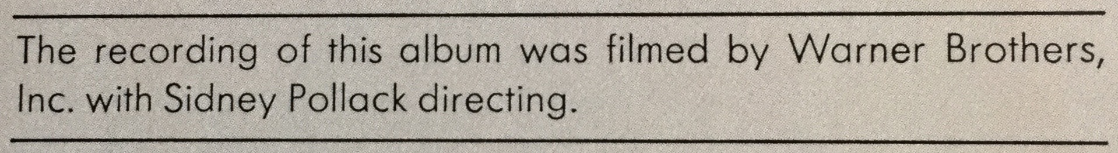

Slide 8


Slide 9
background

Slide 10






Warner Communications, parent company of Warner Brothers Films and the Warner, Reprise, Elektra and Atlantic labels, were in the midst of “corporate synergy” with the success of the 1970 film and album of “Woodstock”.
Warners had paid $100, 000 for the rights; the film grossed $17 million and the album sold three million copies.

Slide 11











Atlantic Records was part of Warner Communications, which owned Warner Brothers Films.
With the success of “Woodstock,” Warner Brothers Films readily agreed to film the “Amazing Grace” sessions.

Slide 12


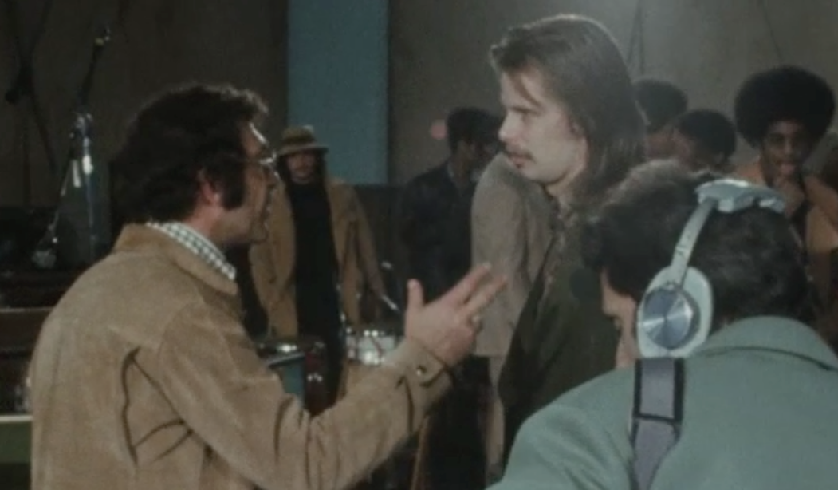

Warner Brothers’ Director of Music Services Joe Boyd, newly arrived in LA after making his mark as a producer in Britain (Nick Drake, Pink Floyd, Fairport Convention etc) proposed hiring Jim Signorelli, a documentary film-maker and his team of 16mm cameramen, all veterans of shooting live music. Before Signorelli’s deal could be signed…
Warner Brothers’ CEO Ted Ashley mentioned the project during a meeting with Pollack, who had been recently been nominated for an Academy Award as Best Director for “They Shoot Horses Don’t They” and whose film, “Jeremiah Johnson” was about to be released by Warner Brothers.
A big fan of Aretha’s…
Pollack enthusiastically signed up to film “The Making of Amazing Grace”.

Slide 13

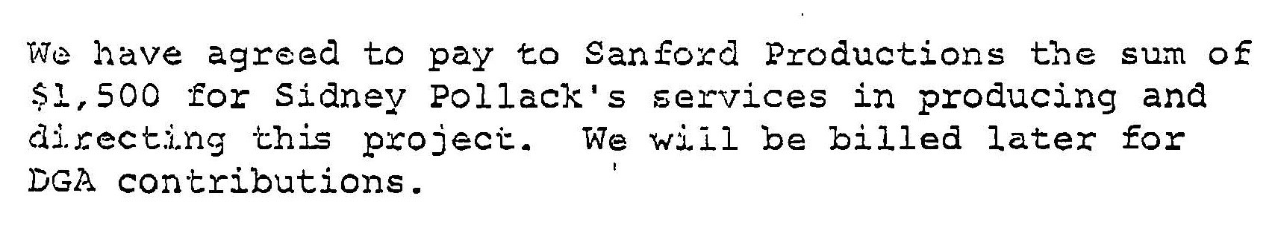

Slide 14


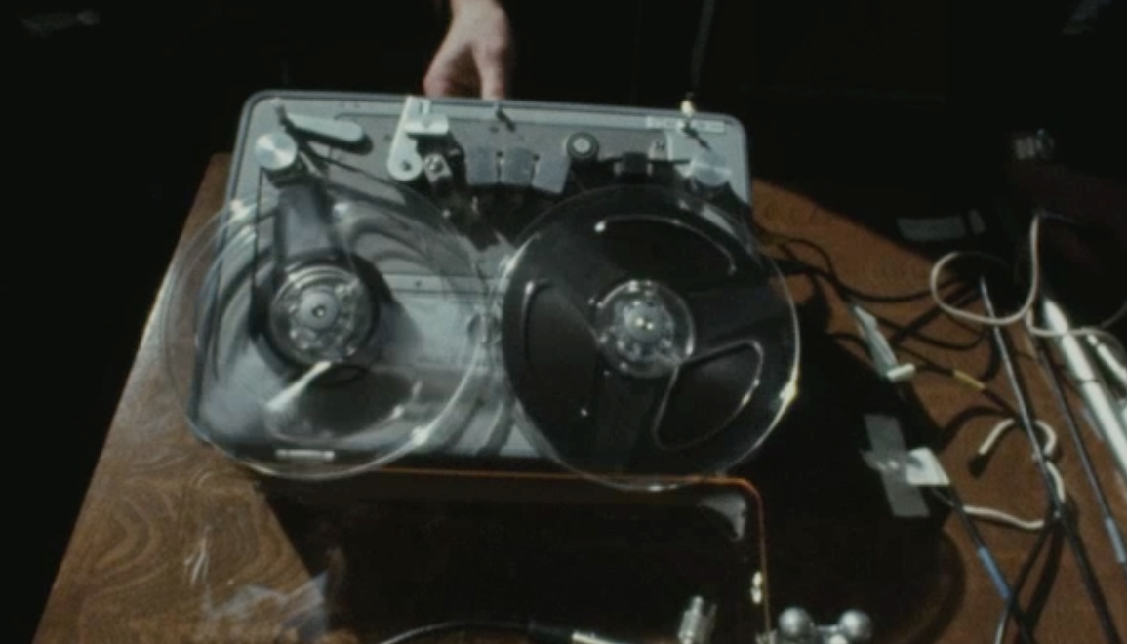
The production ran into bad luck.
There were no clappers on the shoot so there were no markers to guide the sound into sync with the picture.
To compound the problem, the Nagra tape recorder was running slightly slower than the cameras.
Warners hired lip-readers and specialist editors… with no luck.
After the remarkable two days of recording, the editors- and the studio- gave up.

Slide 15
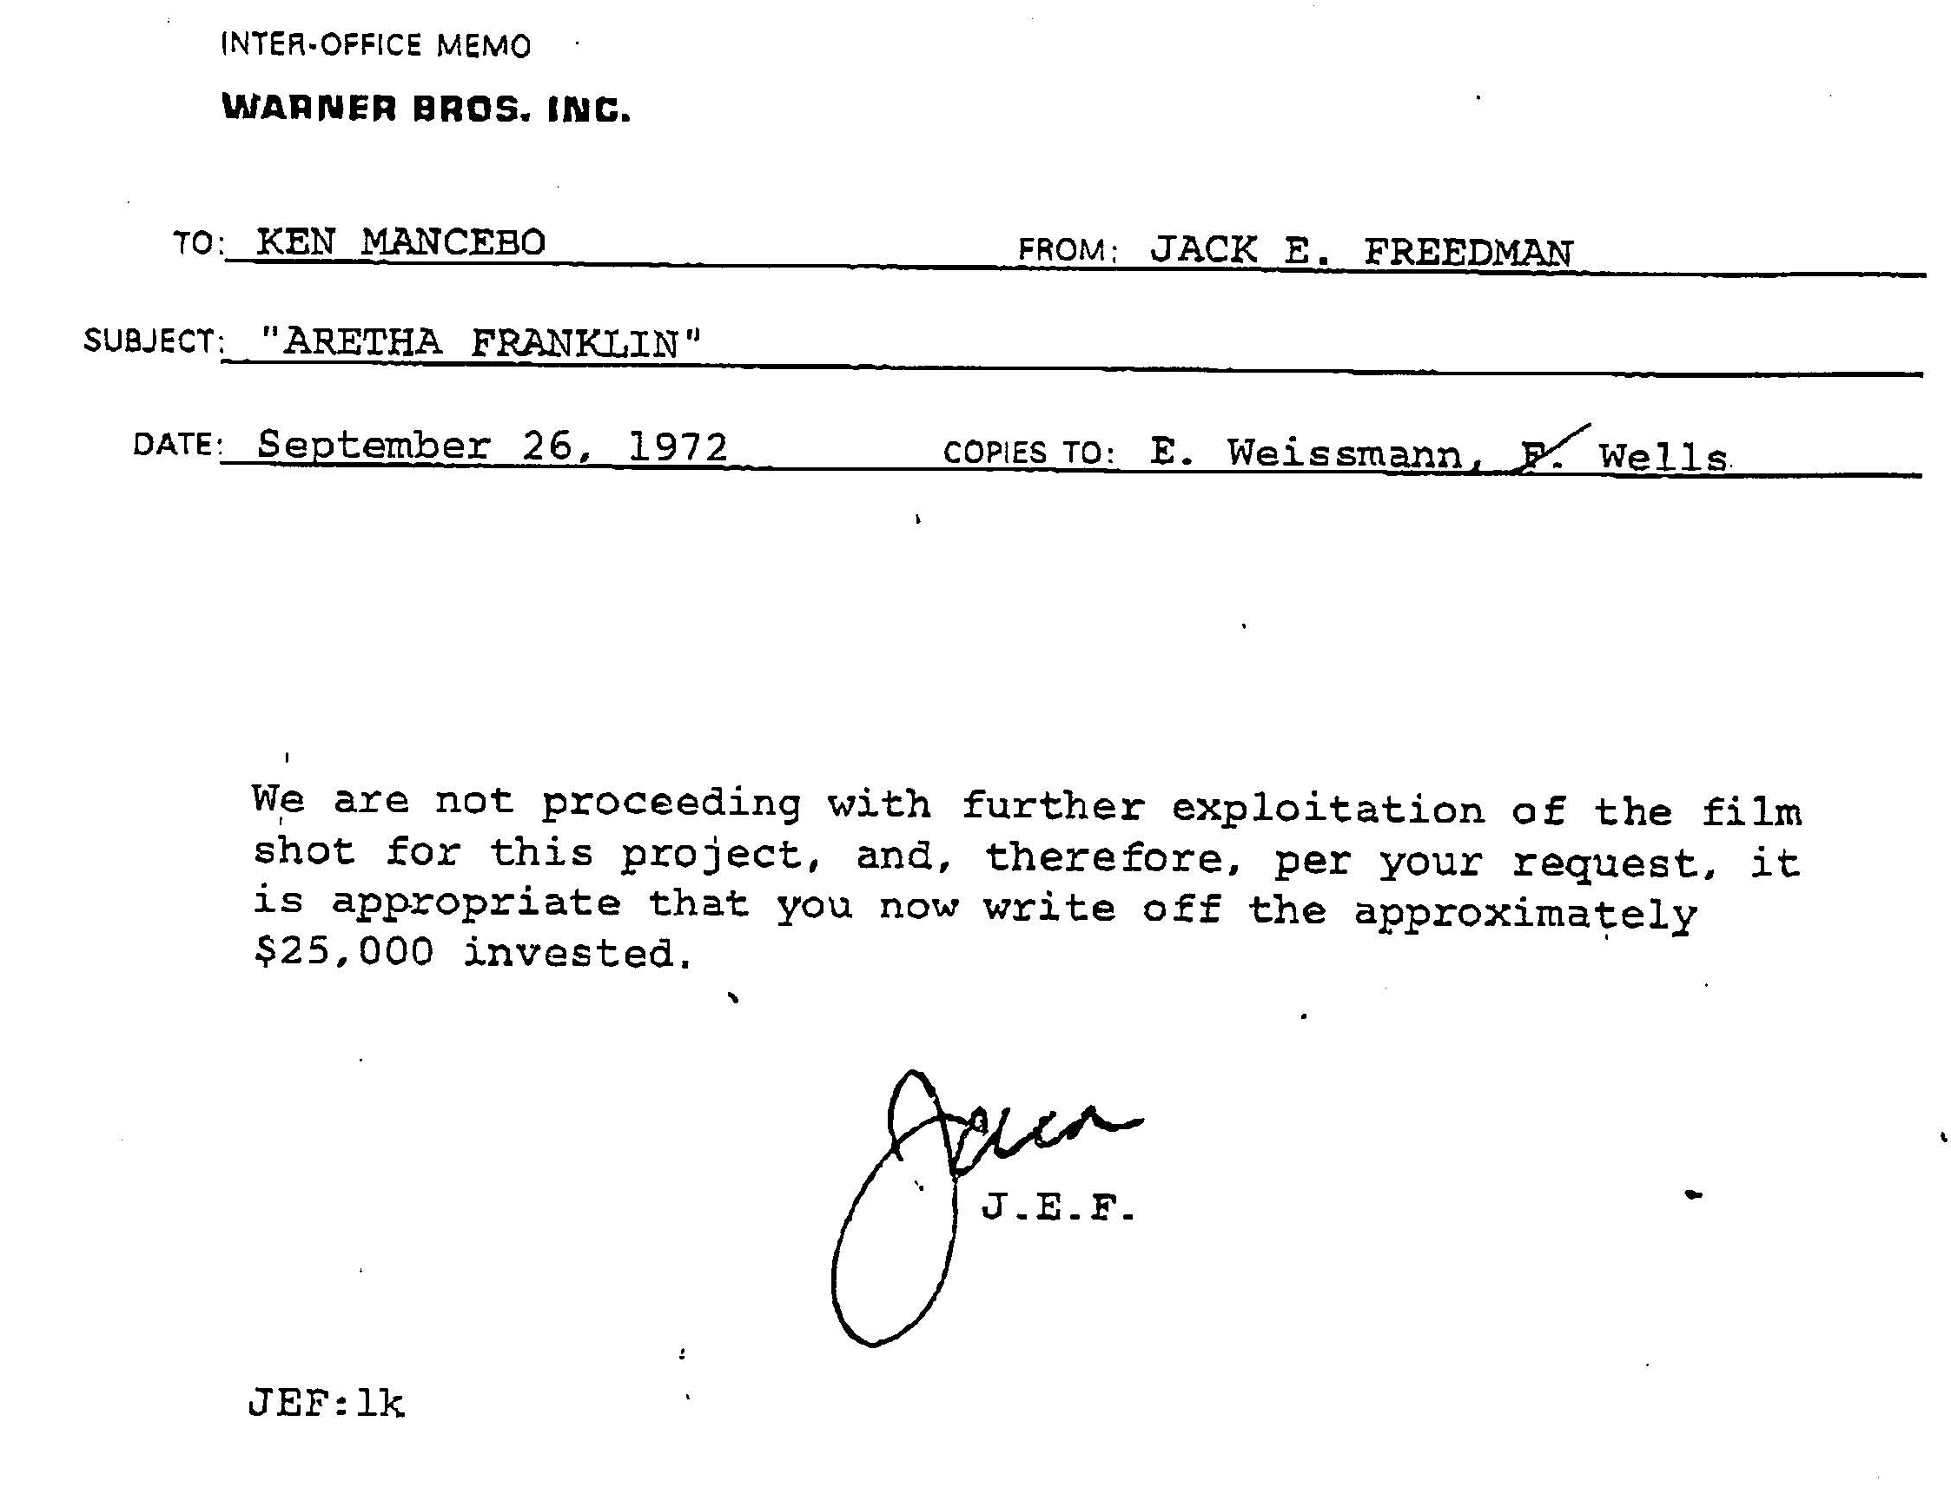

Slide 16

The film was in the Warner vaults for almost 40 years before former Atlantic staff producer/Wexler protégé Alan Elliott came to Wexler and Pollack… and together approached Warner Brothers about finishing the film.

Slide 17
ARETHA HISTORY

Slide 18



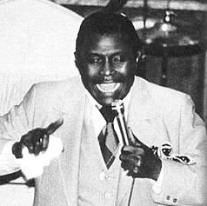




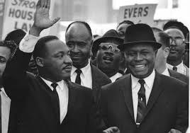
Aretha’s father, C. L. Franklin, was arguably Gospel’s greatest preacher and shouter, a great singer, a friend and colleague of Martin Luther King and a powerful figure who toured the country with a Gospel show that included Aretha as soon as she was old enough to peer over the pulpit.
Aretha learned directly from Mahalia Jackson, from Clara Ward and from Sam Cooke on whom she had a girl-hood crush. “Amazing Grace” was her return home, her tribute to her family and to the childhood that had shaped her.

Slide 19






Aretha spent her formative life singing in church. Sam Cooke, Little Richard, Otis Redding, Dinah Washington, Jackie Wilson, the Staples Singers, Ray Charles… the list of singers whose secular singing was informed by their church background is endless.
Aretha’s became a “synthesist” of Mahalia Jackson, Alex Bradford, Clara Ward, Marion Williams, the Swan Silvertones and the other great figures of the Golden Age of Gospel.

Slide 20










Atlantic Records
Atlantic had pioneered the selling of black music to white audiences: The Coasters, The Drifters, Ruth Brown, Ray Charles, Solomon Burke, Otis Redding, Sam & Dave, Wilson Pickett head a huge list of African-American stars the label marketed during the 1950s and 1960s.

Slide 21







Aretha had originally been signed to Columbia Records by the great John Hammond, talent-spotter of Billie Holiday, Count Basie, Bob Dylan and Bruce Springsteen.
When her Columbia career failed to ignite, Atlantic took her on and, under the brilliant guidance of Jerry Wexler (the man who invented the term ‘rhythm and blues’) transformed her career.
Starting in 1967, her string of hits – “I Never Loved A Man”, “Respect”, “Baby I Love You”, “Chain of Fools”, “Think”, “Don’t Play That Song” – kept Atlantic at the top of both the pop and r&b charts. Aretha’s success disguised the fact that the label was losing touch with its r&b heritage following the death of Otis Redding and Ray Charles’ defection to a rival company.

Slide 22



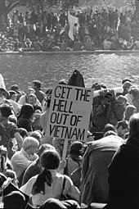






At the time of the recording of “Amazing Grace” in February 1972, Atlantic Records, “Soul” music, Gospel music, the music business in general and the relationship of African-Americans to society as a whole were all in a state of flux.

Slide 23




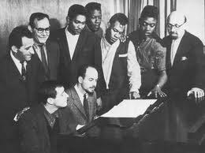
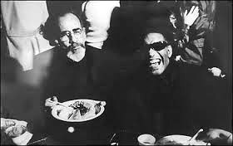




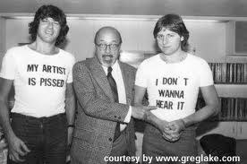
Love of Soul Music, from the Supremes to Al Green, had united America across racial lines.
But by the early ‘70s, corporate largess had devoured the Rhythm and Blues which had been the fundamental of Atlantic.
Atlantic saw it’s future in white rock groups and singer-songwriters.

Slide 24
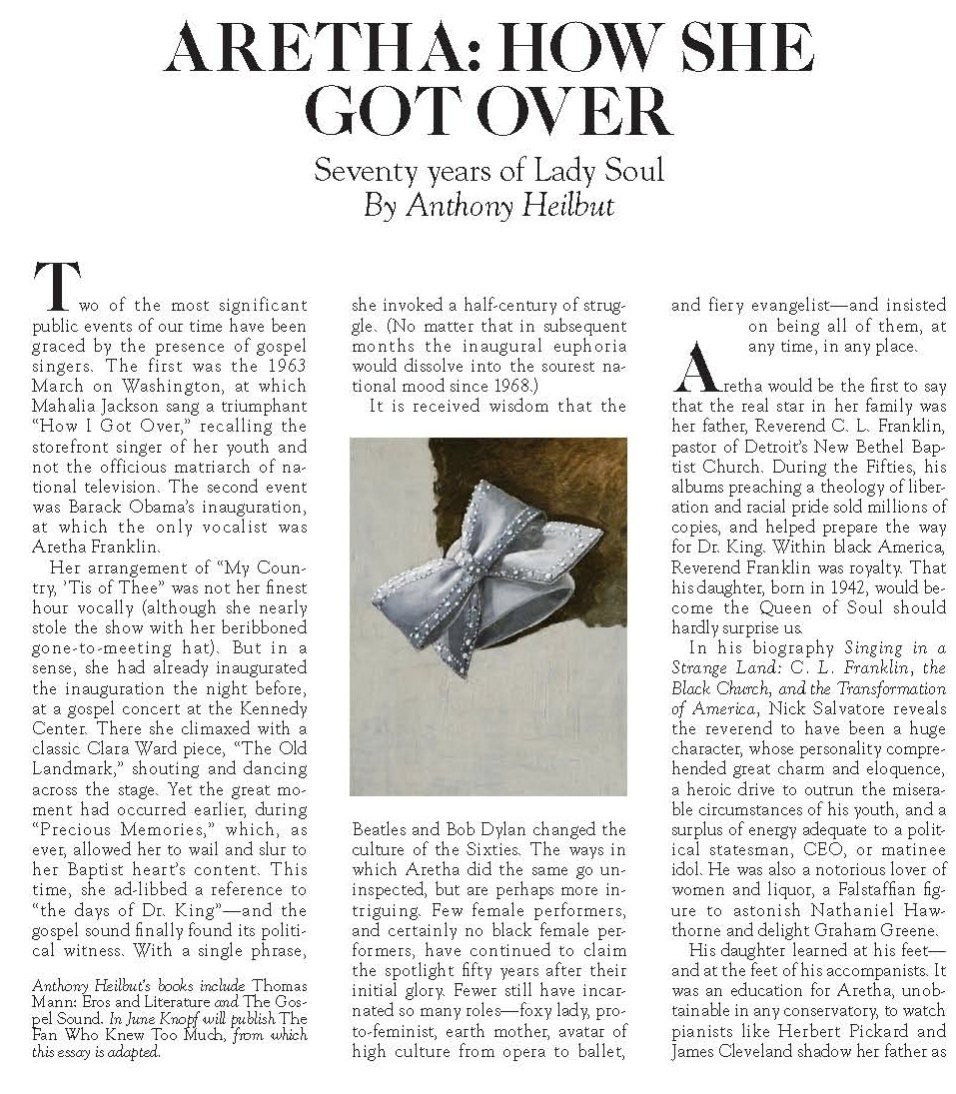

Slide 25
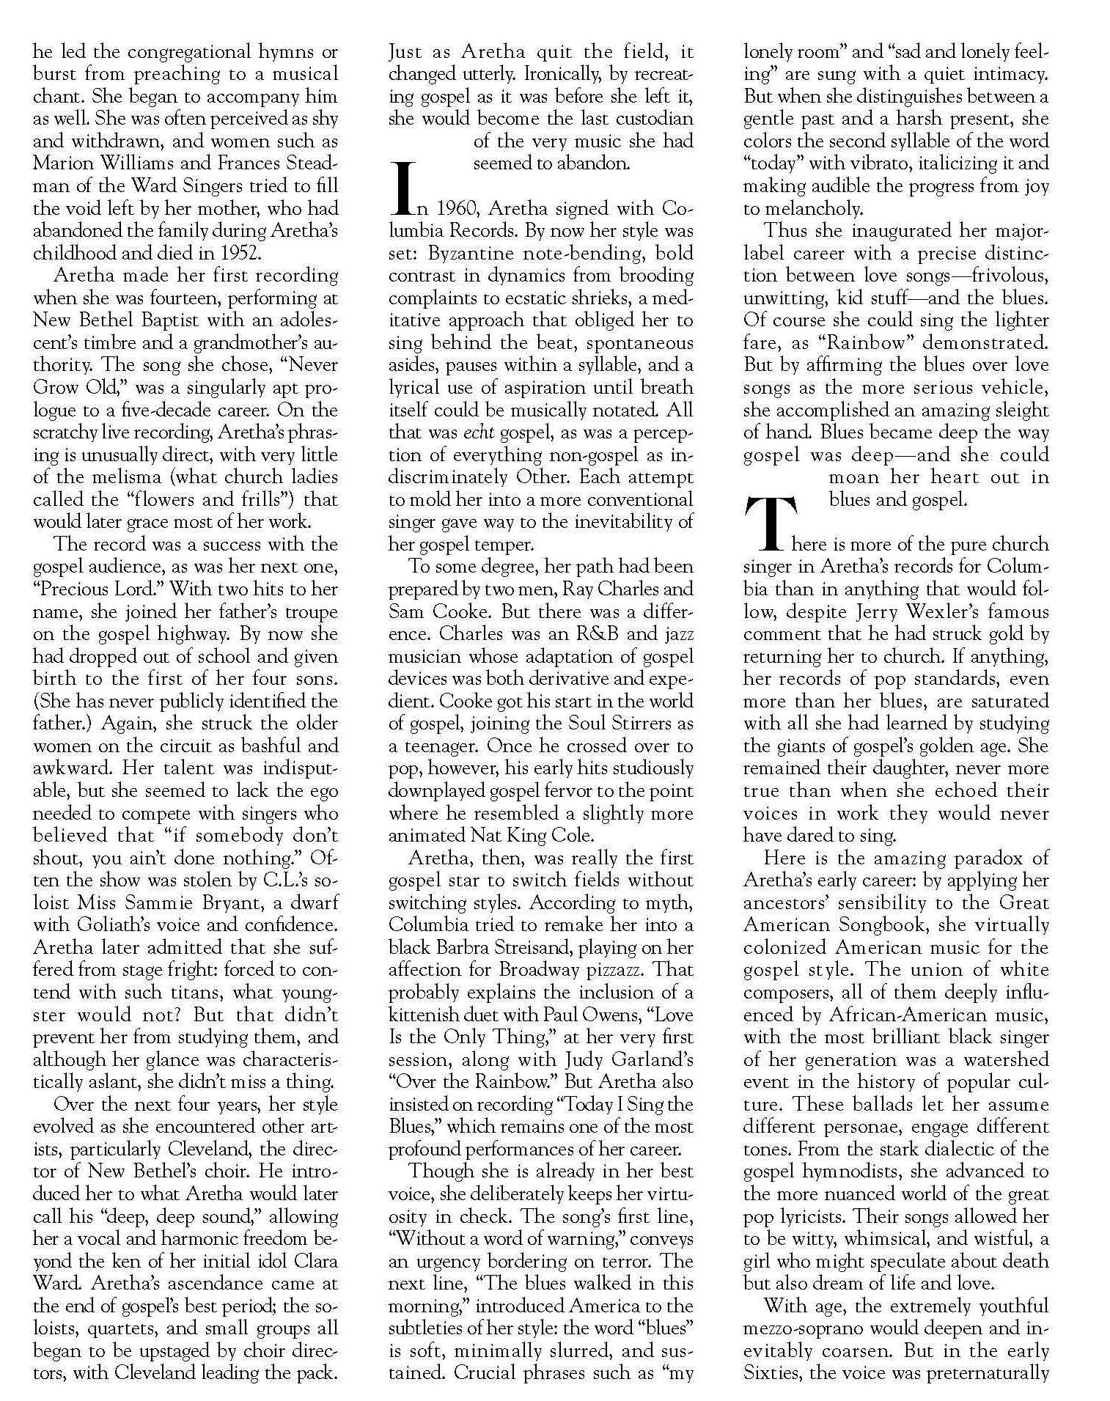

Slide 26
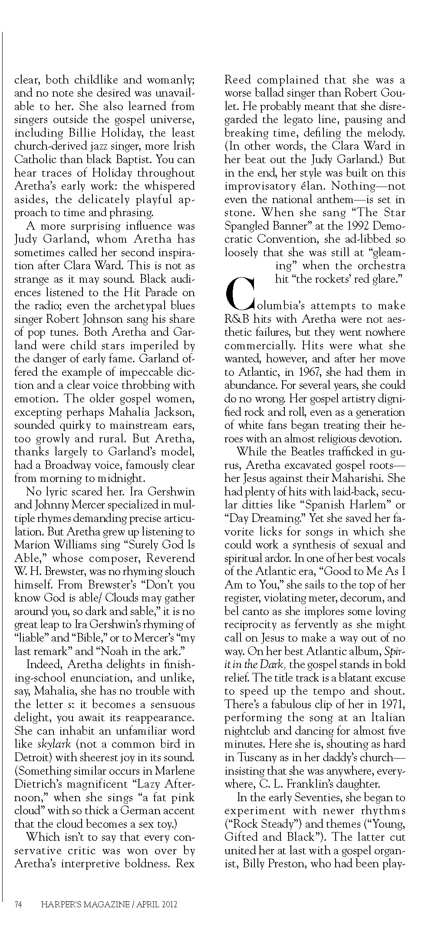

Slide 28
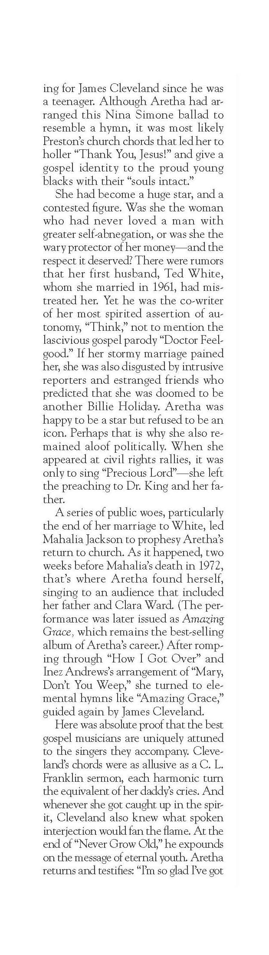
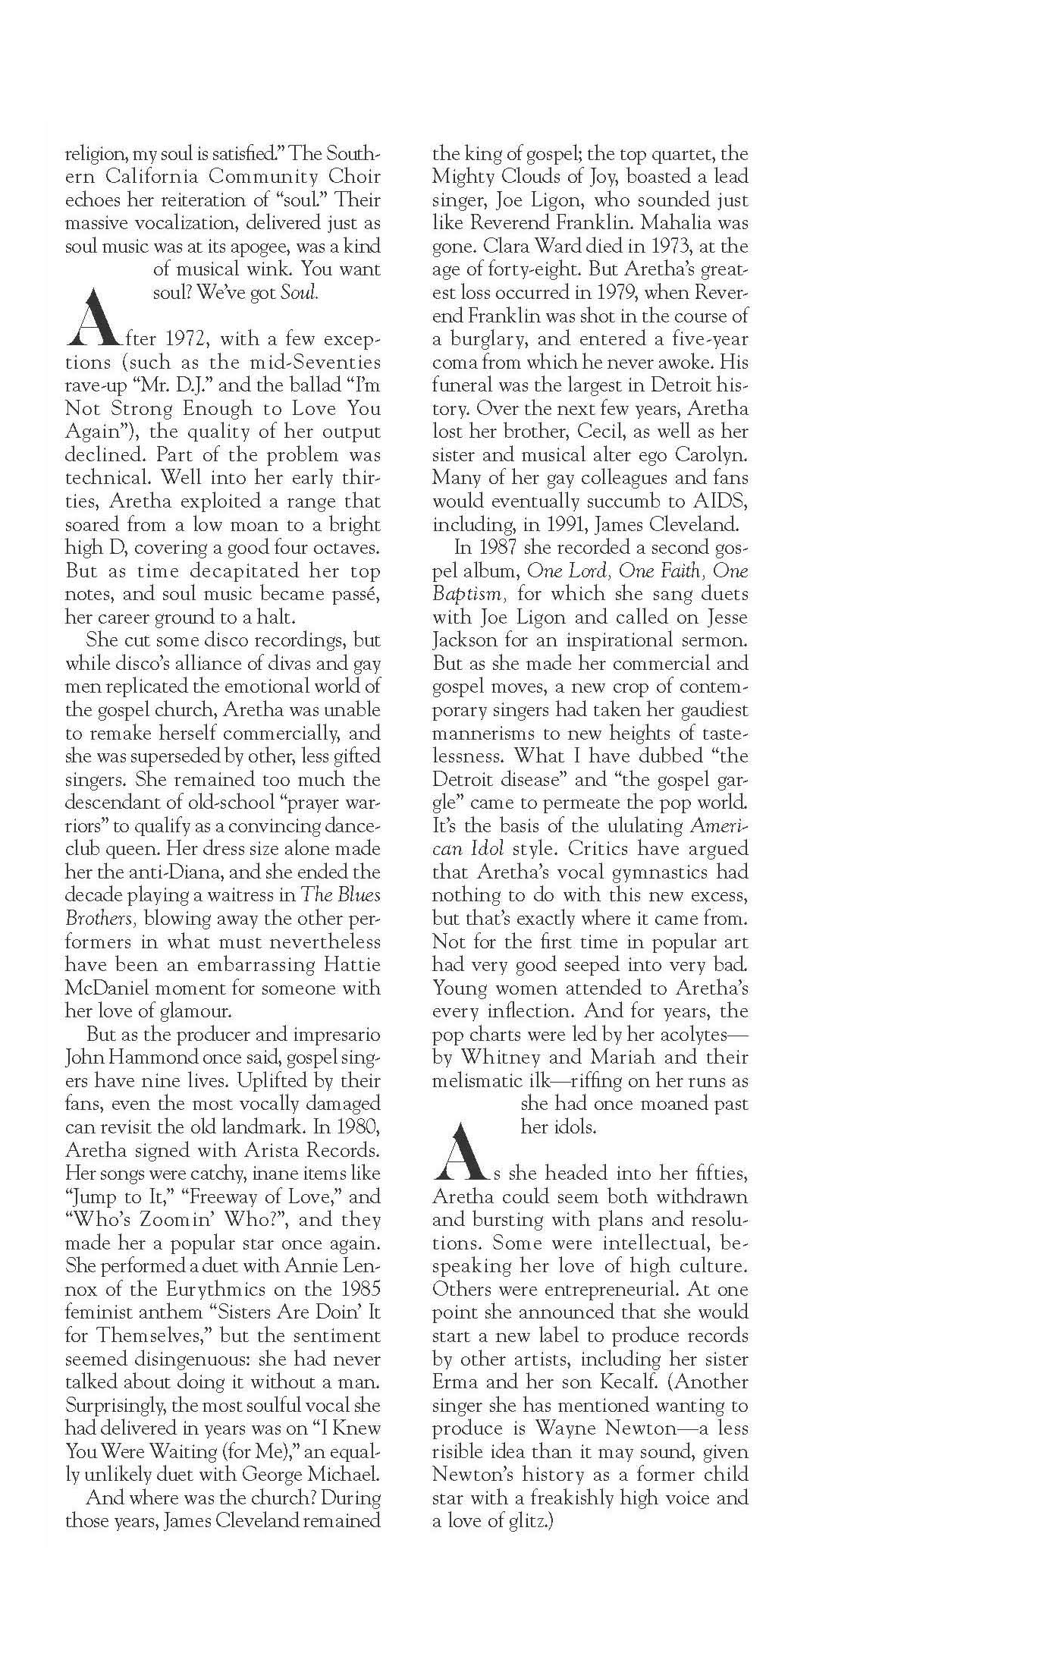

Slide 29
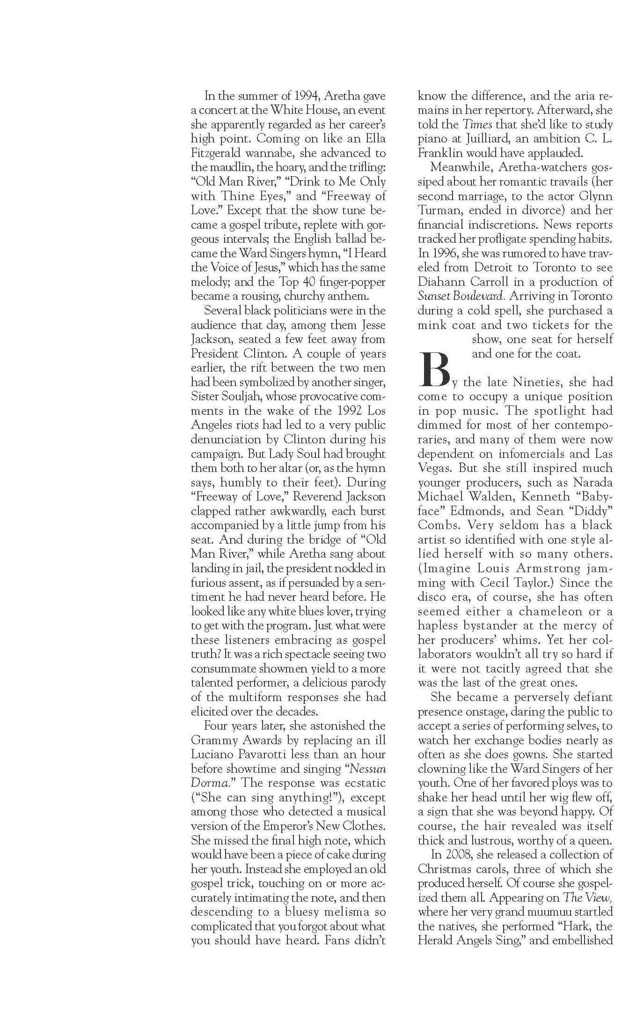
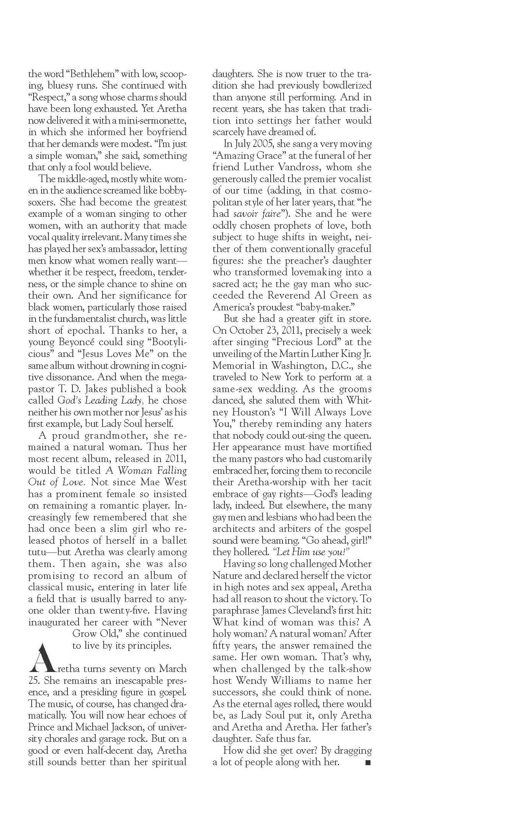

Slide 30

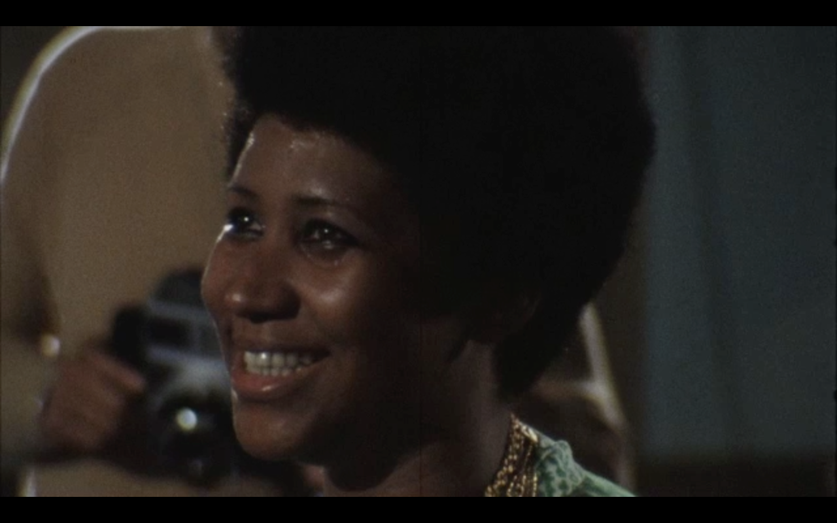

Slide 36
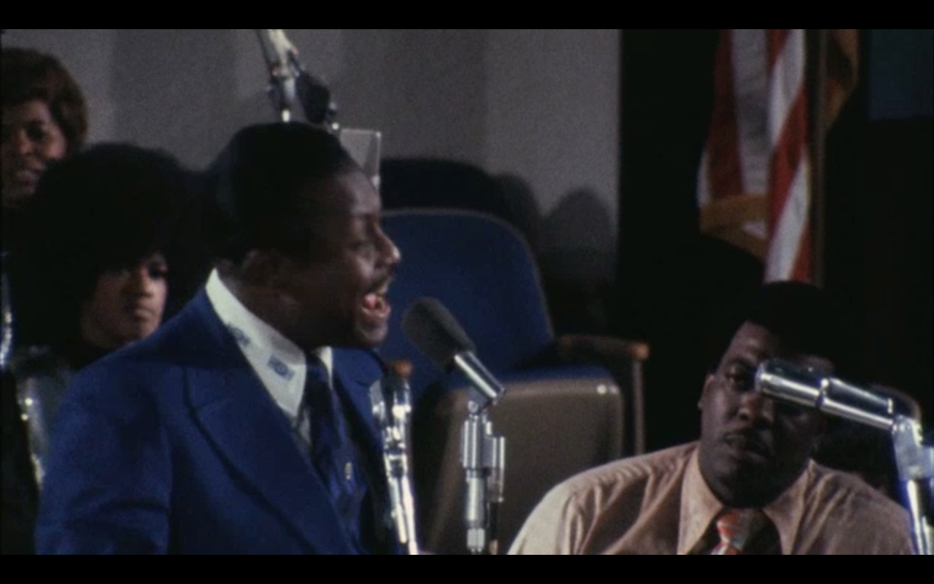

Slide 37
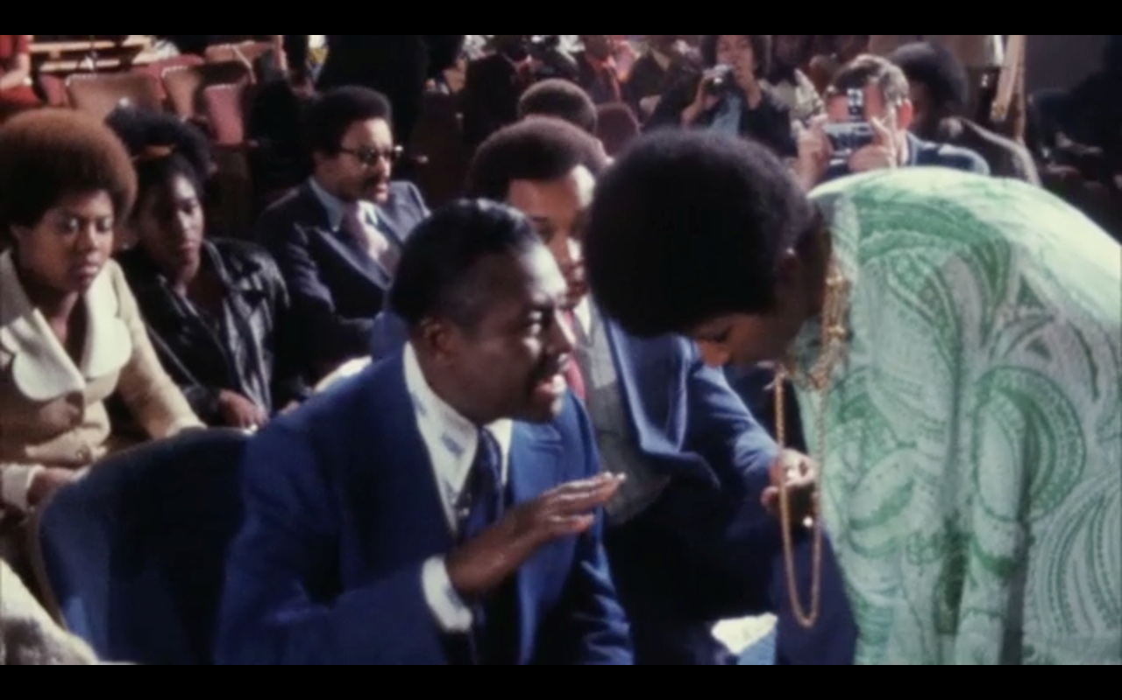
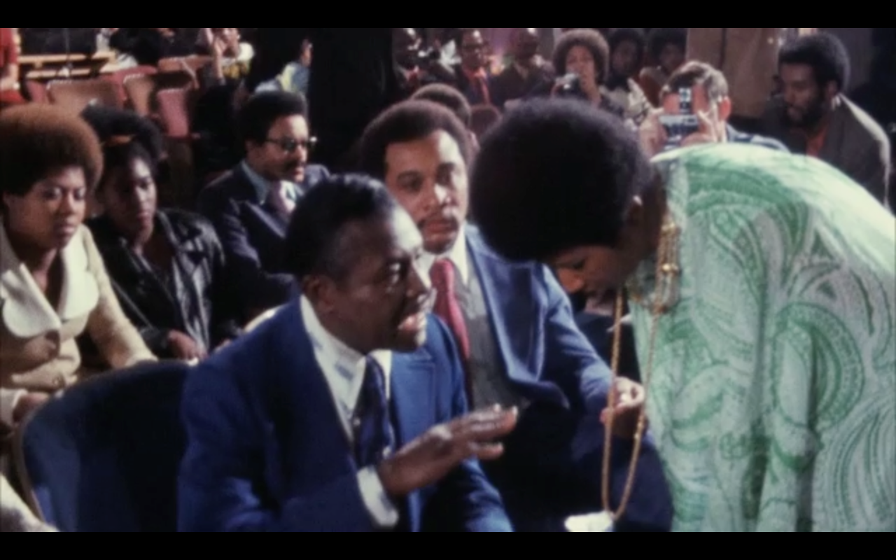

Slide 39
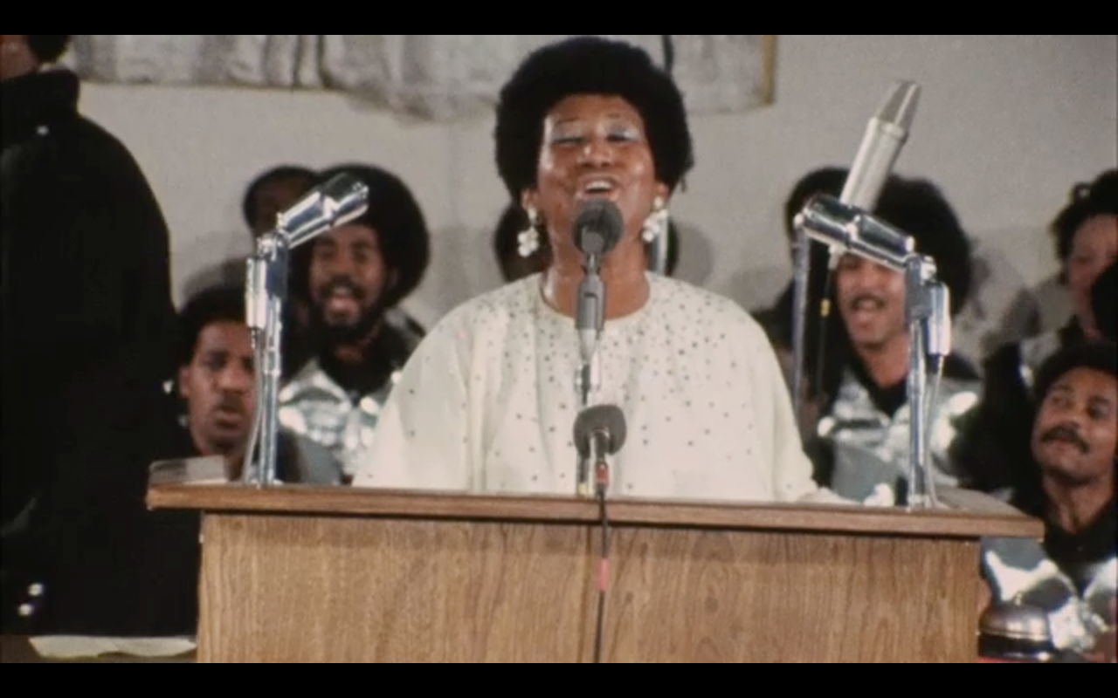

Slide 40

In the crowd were Mick Jagger and Charlie Watts of the Rolling Stones (who were in Los Angeles recording “Exile On Main Street”)… along with Gospel legends Clara Ward and Mother Ward of the Ward Family Singers…

Slide 41
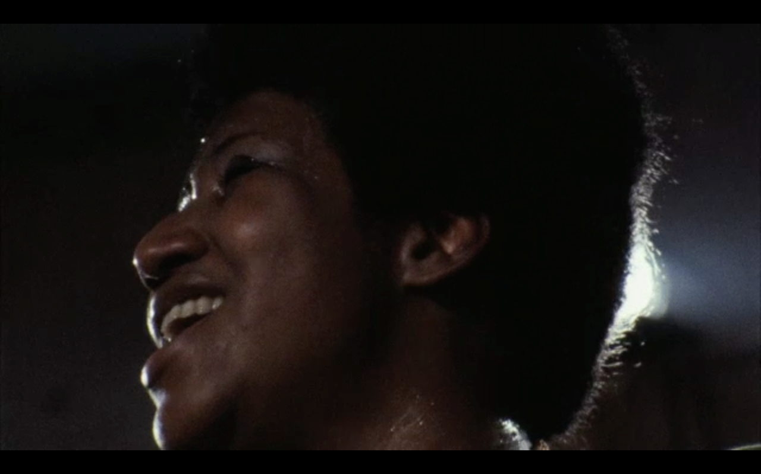
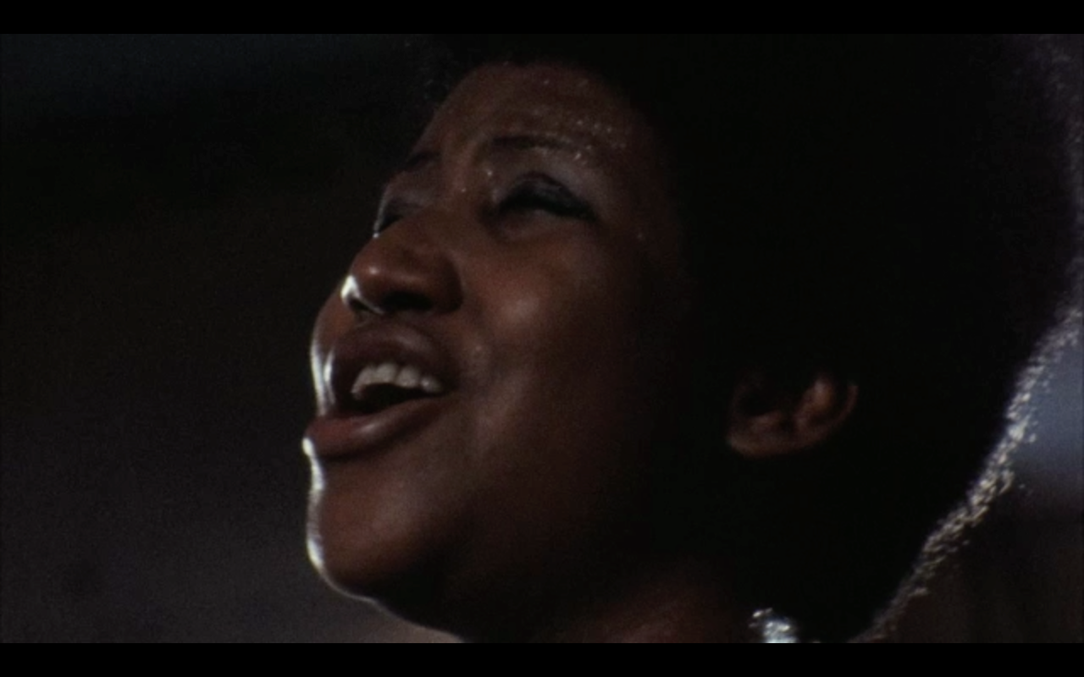

Slide 42

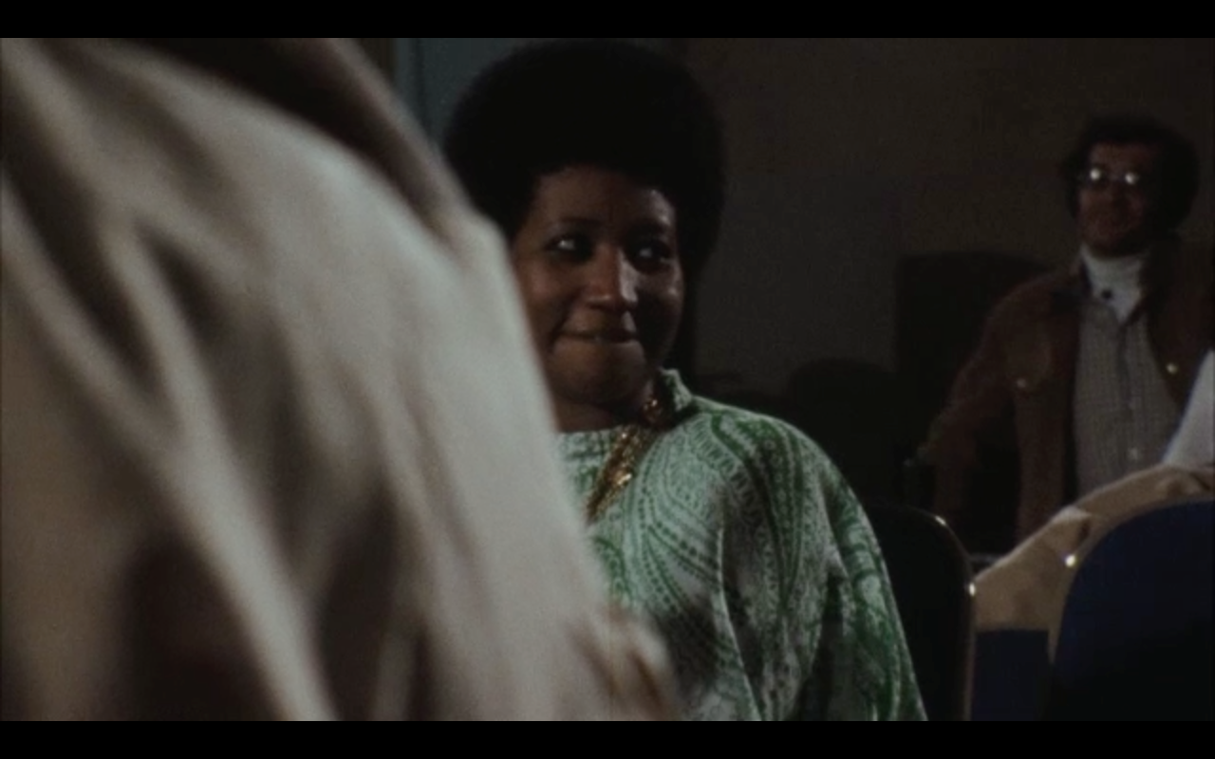
Through many dangers…
“Amazing Grace”…
is the premier document of American musical history ever filmed.

Slide 43
deluxe labs:
Gray Ainsworth
Beverly Wood
legal:
Todd Musburger
Special Thanks:
Ari Emanuel
Matt Farmer
Julie Huntsinger
Phil Jackson
Tom Luddy
Peter Sellars
Originally recorded live at
the New Temple Missionary Baptist Church,
Los Angeles, California.
Recording engineer:
Ray Thompson for Wally Heider
Atlantic Records Staff assistant engineers:
Jimmy Douglass
Gene Paul
George Piros

Slide 44
contact:
Alan Elliott
323.988.9692
alan@alanelliott.net
Tirrell D. Whittley
404.892.2836
tirrell@goliquidsoul.com

